Slide 1
CSS - Training

Slide 2
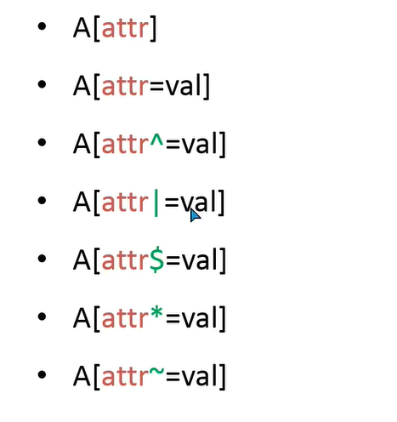
Advanced CSS Selector
Attribute Selectors

Slide 3
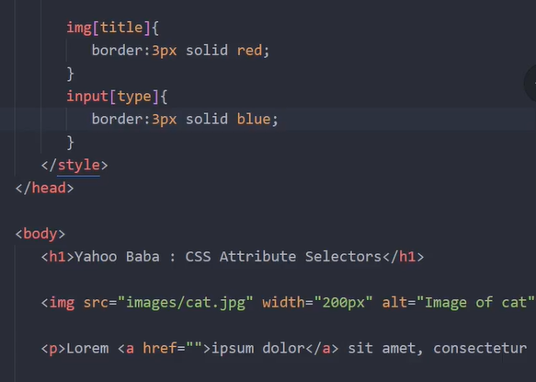
A[attr] – targeting attribute

Slide 4
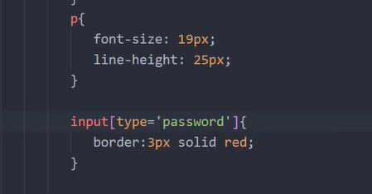
A[attr=val] – matching value

Slide 5
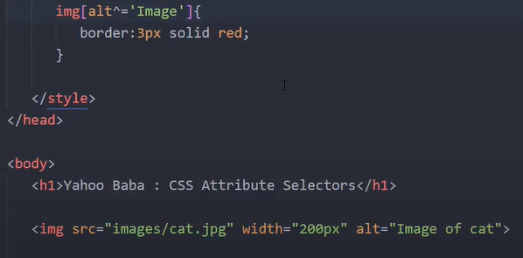
A[attr=^val] – should start with this value

Slide 6
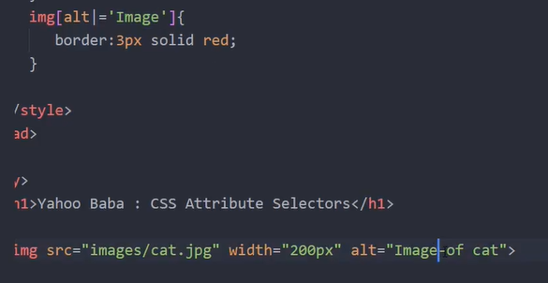
A[attr=|val] – value should have hypen after that

Slide 7
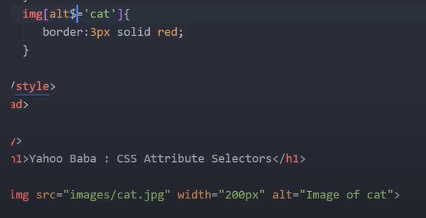
A[attr=$val] – value end with this value

Slide 8
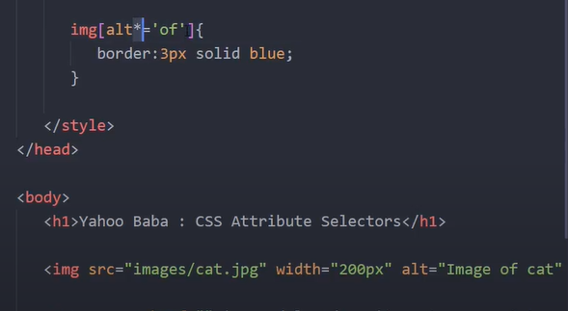
A[attr=*val] – match with value anywhere

Slide 9
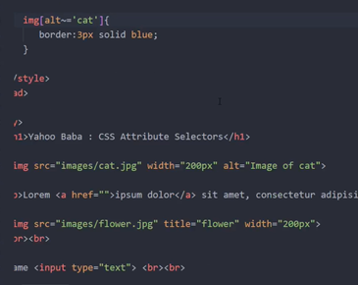
A[attr=~val] – similar like * but space should be there between word

